Slide 1
Steam Heat Controller
for Coover Hall
May11-19
Group Members:
  Ben Jusufovic
  Ben Cao
  Thinh Luong
  Curtis Mayberry
Advisers:
  Jason Boyd
  Lee Harker

Slide 2
Overview
Overview
Requirements
Design
Implementation
Testing
Conclusion
Questions

Slide 3
Project Overview
Problem Background and Statement
  The old section of Coover hall utilizes steam valves to heat adjacent rooms. A steam valve in one room can control the temperature of up to five rooms. This leads to temperature offset in the rooms and continuous adjustment of the valve in order to accommodate the individuals within each room.

Slide 4
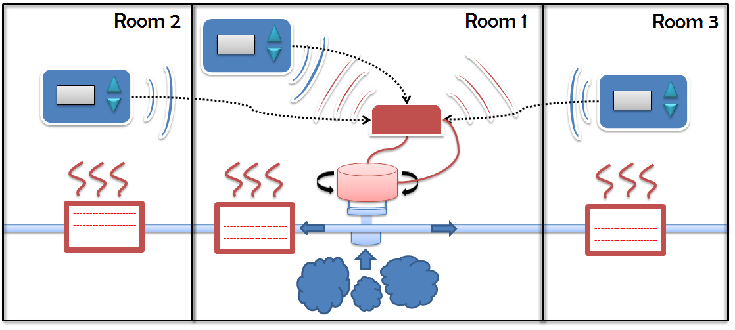
Project Requirements
Effective temperature control
Removable mechanical Interface
Wireless user interface
Web interface
Large graphic LCD
Casing size
Casing color
Project budget

Slide 5
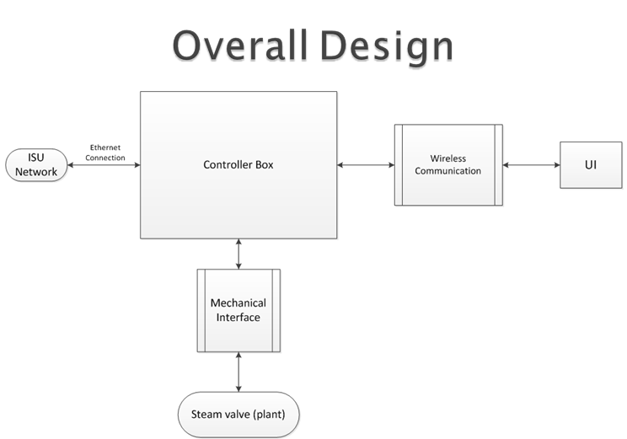
Project Design

Slide 6
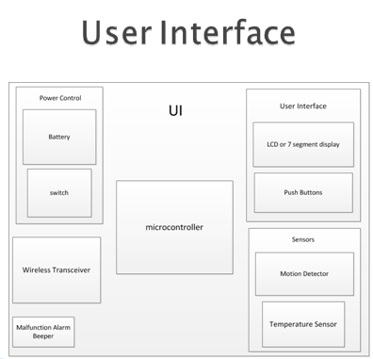
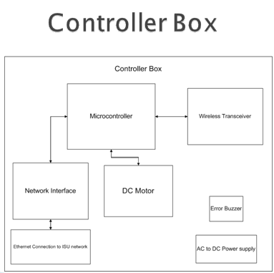
Project Design

Slide 7
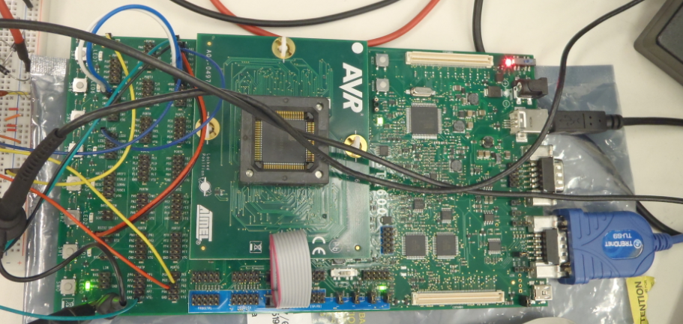
Project Implementation
AVR STK600 Development Kit

Slide 8
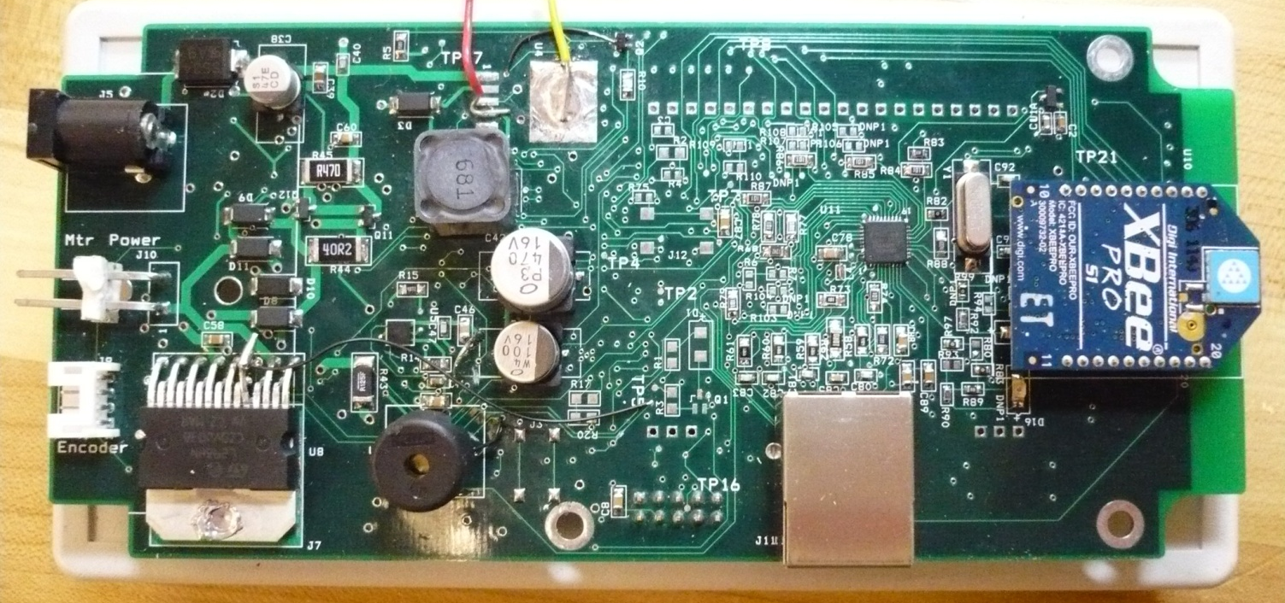
Project Implementation
Controller Box
  Microcontroller
  Wireless Transceiver
  Ethernet Module
  Buzzer
  Power Supply
  Motor Driver Circuit

Slide 9
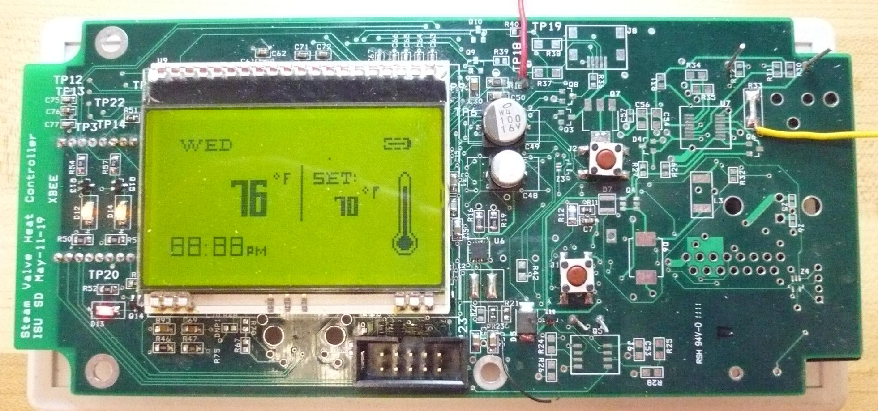
Project Implementation
Control Panel
  Microcontroller
  Wireless Transceiver
  LCD Display
  Power Supply
  Buzzer
  Push Button
  Temp Sensor
  Recharging Circuitry
Notes:
Buzzer
Push Buttons
Temperature Sensor
Recharging Circuitry

Slide 10
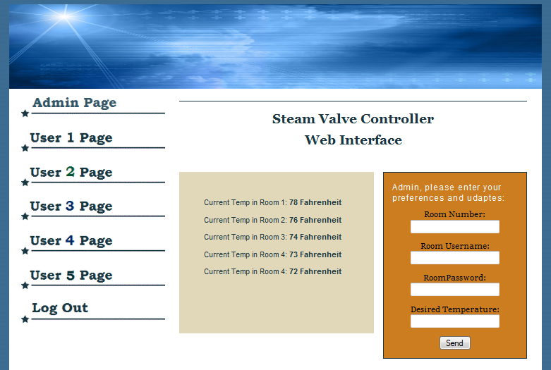
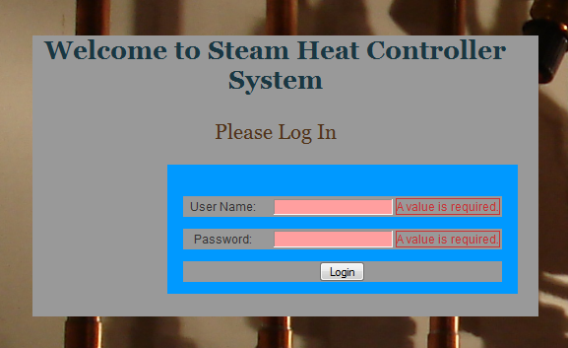
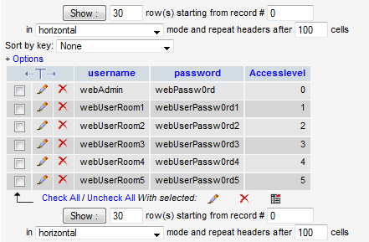
Website Implementation
Website Interface
  Login Authentication
  Access Levels
  Displays Current Temp
  Remotely Set Temp

Slide 11
Integration Testing
AVR STK600 Development Kit
  Microcontroller
  Push Button
  Motor System
  Temperature Sensor
  LCD
  Wireless Transceiver

Slide 12
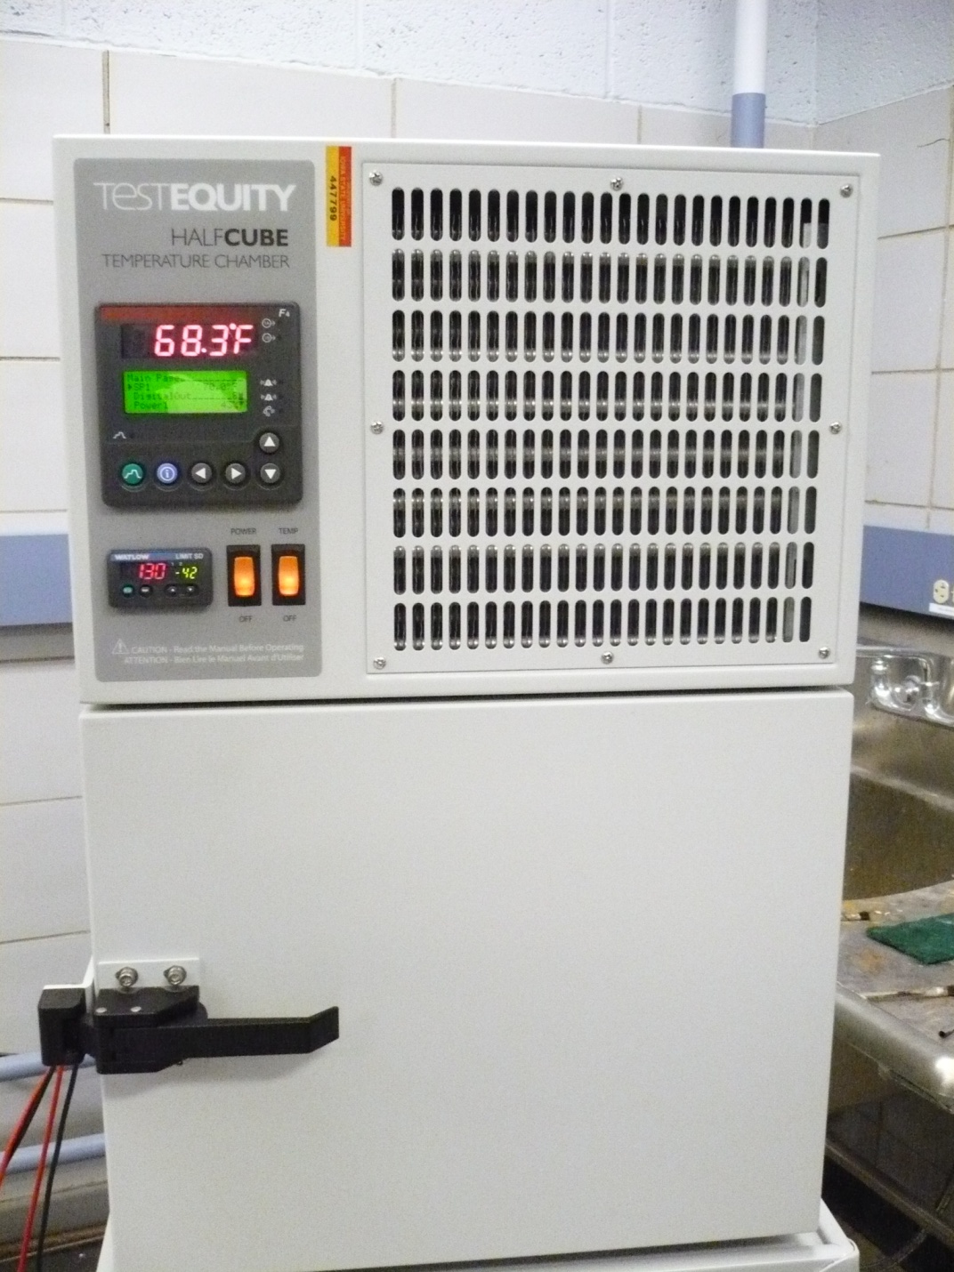
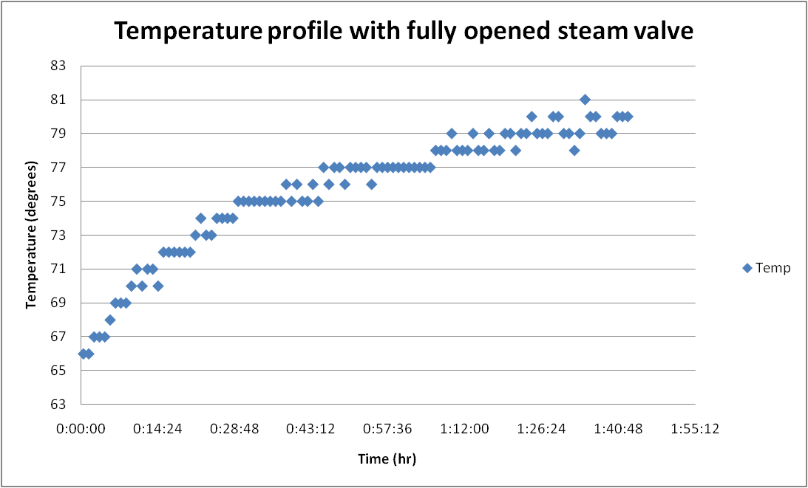
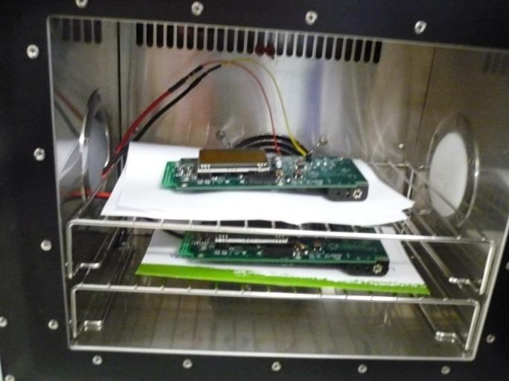
Functional Testing
Simulate operating environment
System performance test

Slide 13
Lessons Learned
PCB Board
  Floating pins
  Power line routing
  Inductor selection
Microcontroller
  Integrated Ethernet
  Less functionalities
  Provide external clock
Motor
  Filtering current sense
  Encoder with index channel

Slide 14
Conclusion
3 Control panels
1 Controller box
Website
Successful implementation
Possible improvements:
  Completion of the recharging circuitry
  Ethernet connection
  Additional testing
    various seasonal and environmental conditions

Slide 15
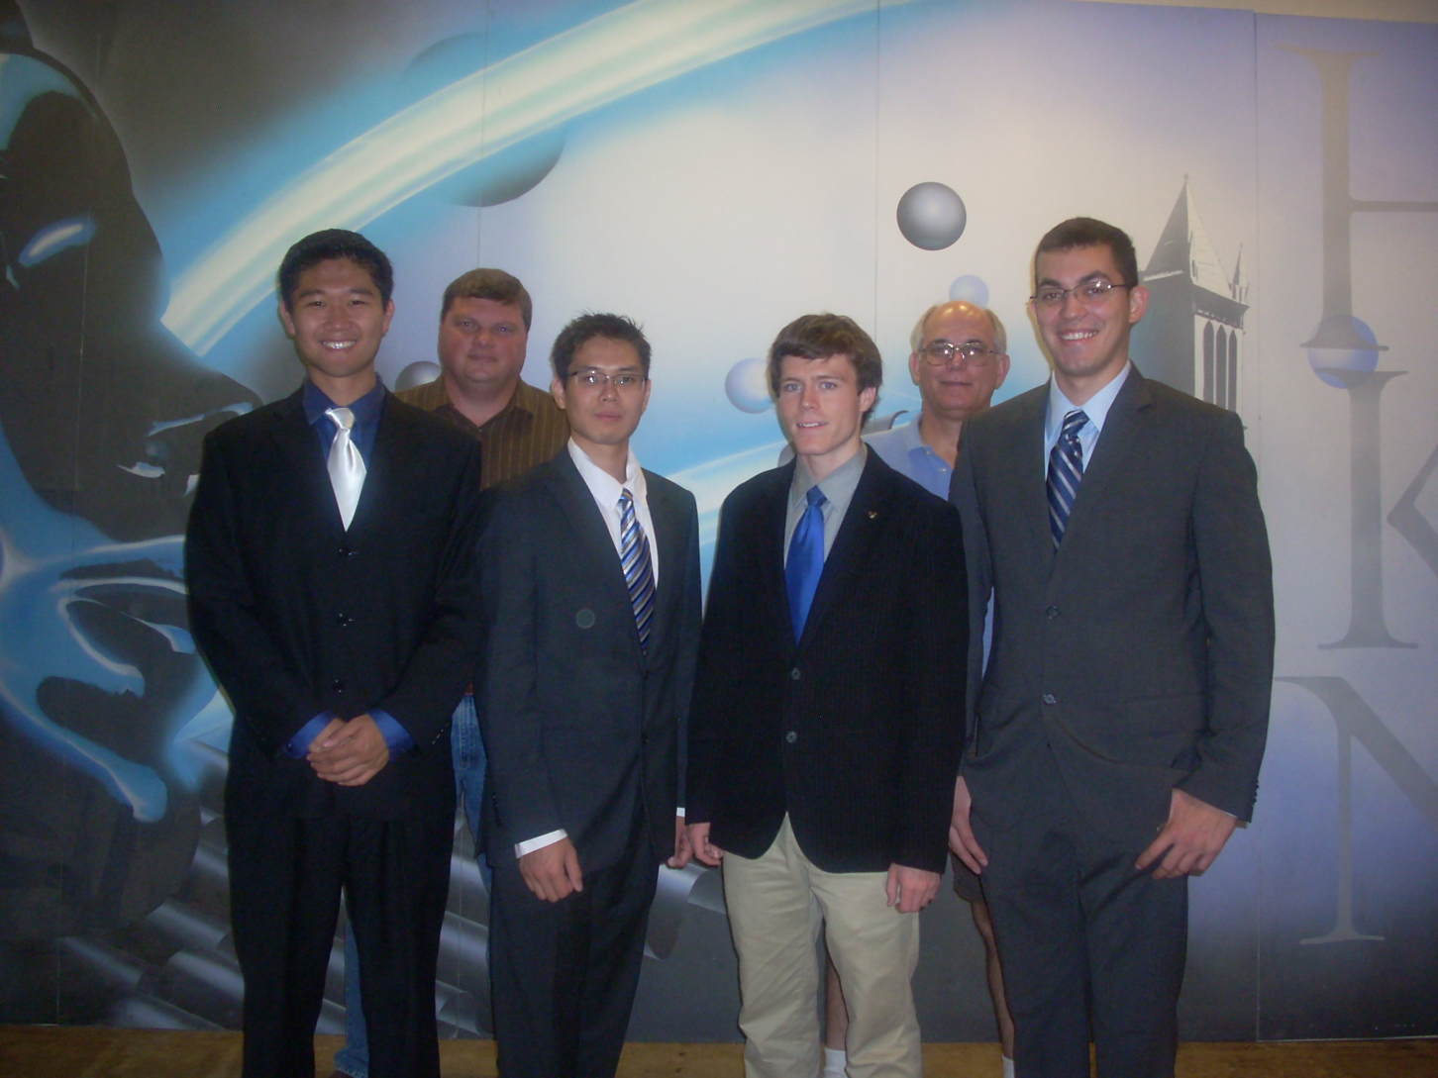
Questions

Slide 16
Thank You

Slide 17
Appendix

Slide 18
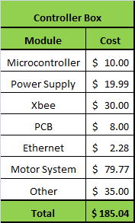
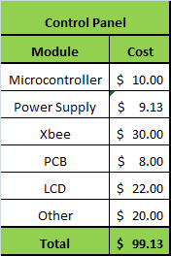
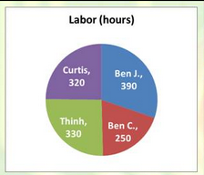
Final Budget

Slide 19
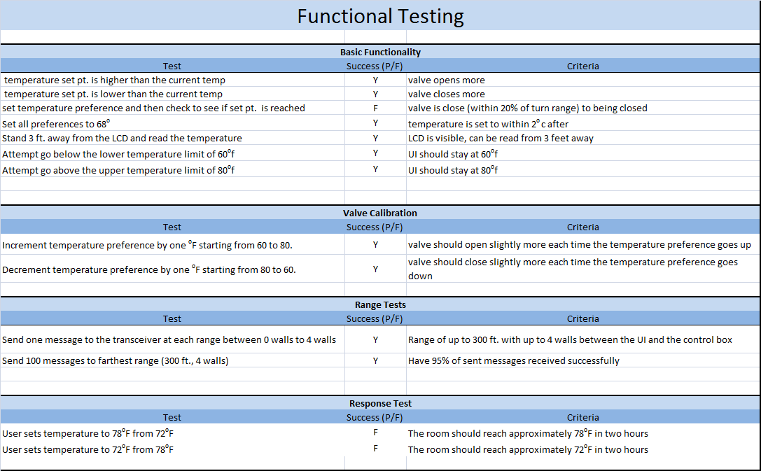
P
P
N/A
P
P
P
P
N/A
N/A
P
P
N/A
N/A

Slide 20
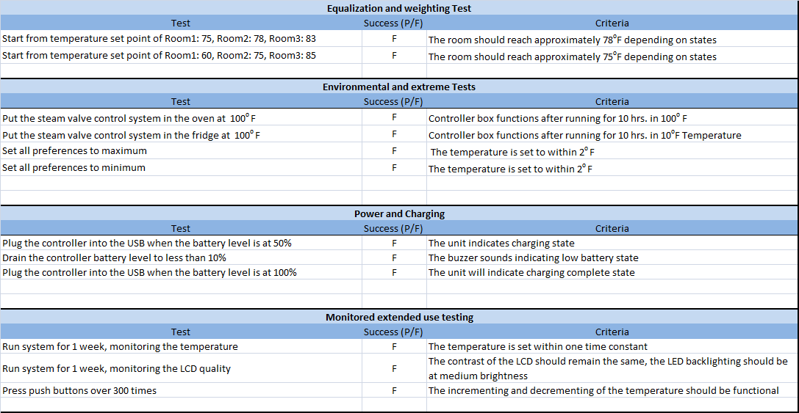

Slide 21
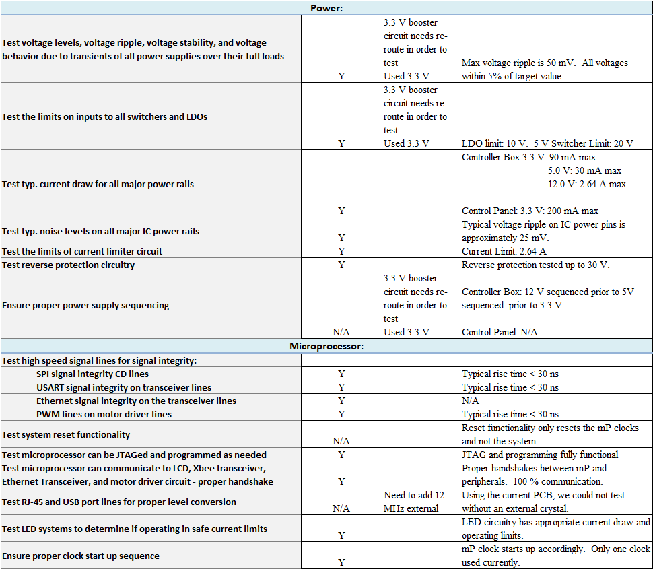

Slide 22
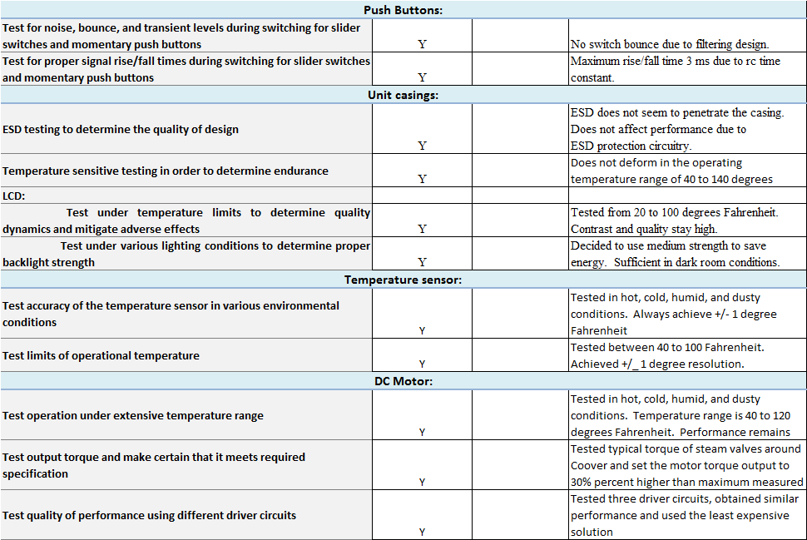

Slide 23
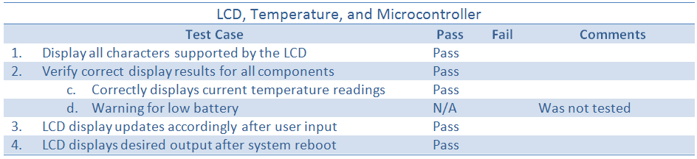
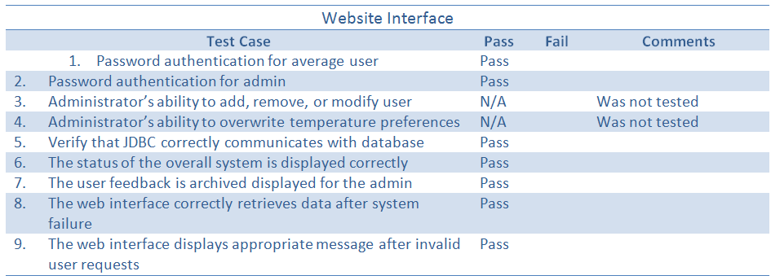
Software Testing Results

Slide 24
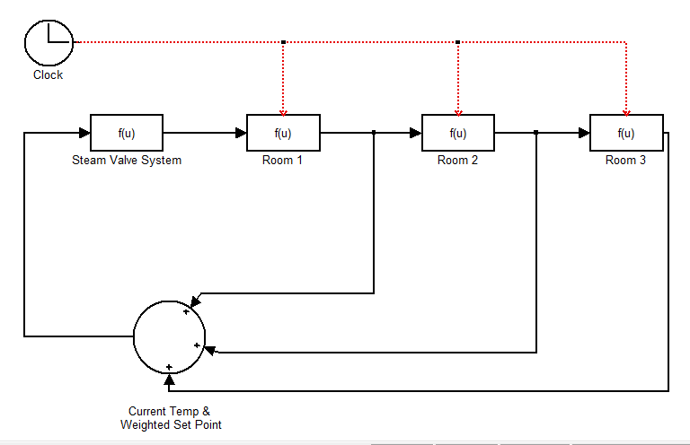
Simulink set up

